Slide 1
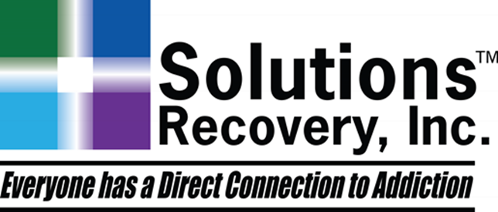

Recovery 2018

Slide 2
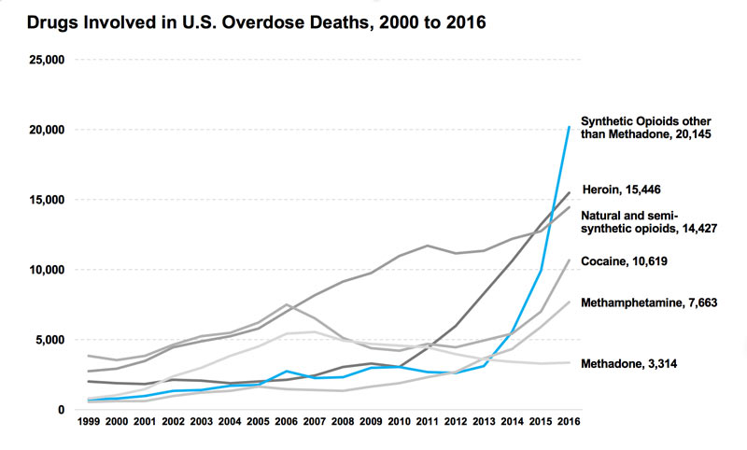
Drugs Involved in U.S. Overdose Deaths
Among the more than 64,000 drug overdose deaths estimated in 2016, the sharpest increase occurred among deaths related to fentanyl and fentanyl analogs (synthetic opioids) with over 20,000 overdose deaths. Source: CDC WONDER

Slide 3
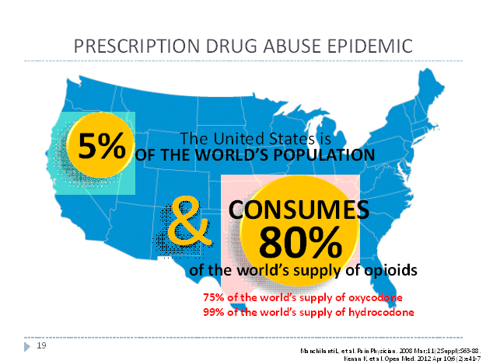

Slide 4
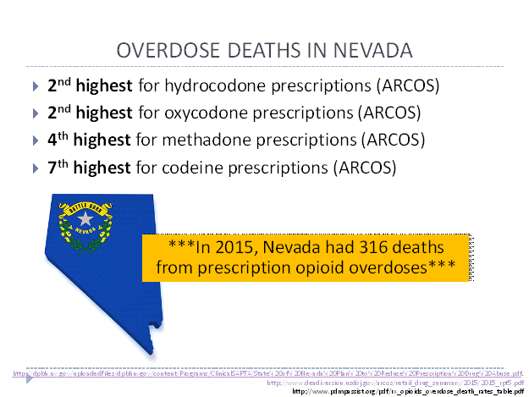

Slide 5
David Marlon – MS, MBA, CADC
Co-founded Solutions Recovery in 2005, serving as President and CEO
Consummated transaction selling assets to American Addiction Centers (NYSE: AAC) in May 2016
Founded three non-profit organizations dedicated to alcohol and drug education and prevention
Prior to forming Solutions Recovery, worked in the insurance industry
More than 30 years of experience serving as the CEO, President and COO in various healthcare companies

Slide 6
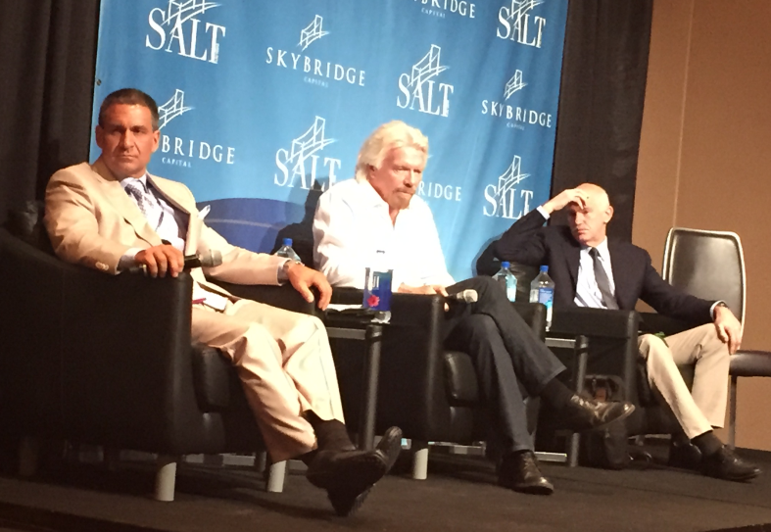
Richard Branson
Sir Branson wanted to debate drug policy
My name is Dave and I’m an Alcoholic
Respectfully marijuana is not safe for me

Slide 7
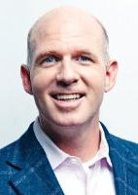

Michael Cartwright
Chairman & CEO American Addiction Centers
Vision
Remove the stigma and medically treat the disease
Built a national respected treatment brand

Slide 8

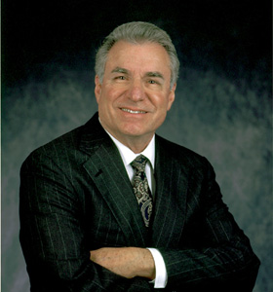
David Siegel
Founder – Westgate Resorts
Taught me to address public policy to advocate for addicts
Increase testing / UA’s
Pay the patient
Naloxone
Money doesn’t protect us from the disease

Slide 9
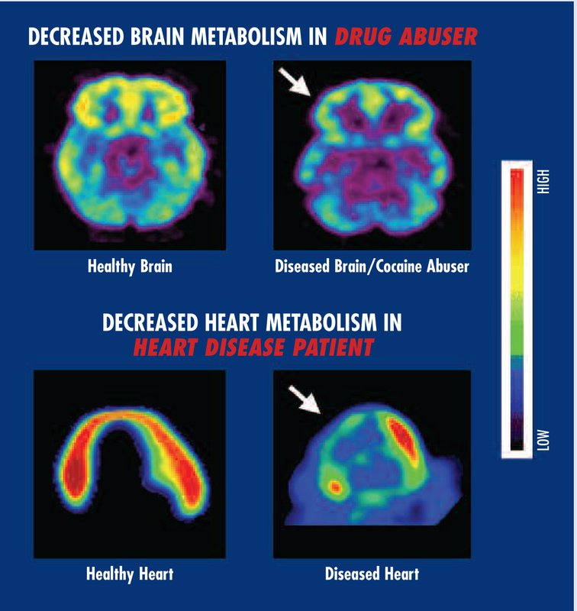
Addiction – a disease
Primary
Chronic
Genetic
Progressive
Fatal

Slide 10
Primary
It has its own symptoms which are identifiable across the population of its victims.
It has a predictable prognosis if the addiction-prone individual continues to use chemicals.
It is not a symptom of a more serious problem.
Chronic
There is no known cure.
The victim is always susceptible to pathologic chemical use even after years of abstinence.
The symptoms of the disease can be arrested.
Genetic multiple lines of research show that addiction is influenced by genes.
Progressive
A long-term plateau of observable symptoms is not possible.
The physical, emotional, and spiritual symptoms become worse when chemical use continues.
The physiological tolerance for the chemical can increase or dramatically decrease even during abstinence.
Fatal
It is a terminal illness unless the chemical use is permanently stopped.
Chemical dependency deaths are often misrepresented on death certificates.
Physical deterioration (heart disease, strokes, blood pressure problems, etc.)
Accidents while under the influence of chemicals.
Suicides.

Slide 11
Medical Definition of Addiction
Addiction is a primary, chronic disease of brain reward, motivation, memory and related circuitry.
Dysfunction in these circuits leads to characteristic biological, psychological, social and spiritual manifestations.
This is reflected in an individual pathologically pursuing reward and/or relief by substance use and other behaviors.
Like other chronic diseases, addiction often involves cycles of relapse and remission.
Without treatment or engagement in recovery activities, addiction is progressive and can result in disability or premature death.

Slide 12
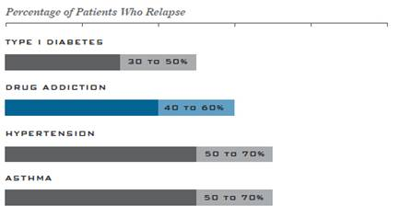
Addiction relapse rate: www.drugabuse.gov

Slide 13
Treatment in 2018
Music: Influence
  Young Thug – Drugs
  Macklemore – Drug Dealer
  Future – Mask Off
MARIJUANA is Legal
PILLS are plentiful – oxycodone highest prescribed drug
VAPE PENS – sold everywhere, from essential oils, to THC and METH
BATH SALTS – Synthetic cathinones
SPICE – Synthetic Cannabinoids
AA hasn’t changed since 1935, but treatment in America sure has

Slide 14
Rehab in 2018
Documentation
Insurance authorizations and denials
Medication assisted treatment
Ethics

Slide 15
Medication-Assisted Treatment
When addiction is confirmed, the use of medication-assisted treatment (MAT), such as Buprenorphine (Suboxone, Subutex), Vivitrol (Naltrexone), ReVia, & Campral have proven to be highly effective in:
  Lowering overdose risk
  Decreasing risk for HIV and Hepatitis C
  Increasing patient retention in treatment
    Vivitrol is 380 mg delivered intramuscularly every 4 weeks or once a month
    Campral is two 333 mg tablets taken three times daily
    ReVia is 50 mg tablet taken once daily
    Suboxone sublingual film is usually 16 mg/4 mg as a single daily dose
    Subutex sublingual tablet administered as a single daily dose
    Methadone available as a tablet, liquid or an injection. Start at 2.5 to 5 mg bid to tid increase by 2.5 to 5 mg per day every 1-2 weeks
    Antabuse The average maintenance dose is 250 mg daily (range, 125 to 500 mg), it should not exceed 500 mg daily.
Buprenorphine Certification

Slide 17
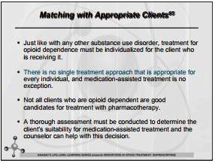
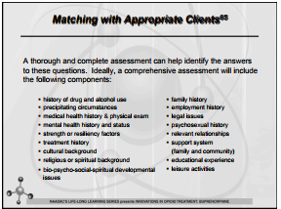

Slide 18
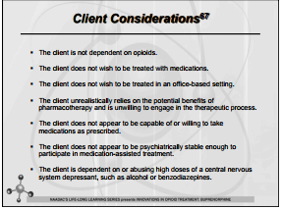
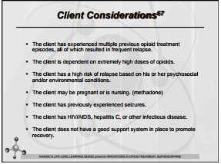

Slide 19
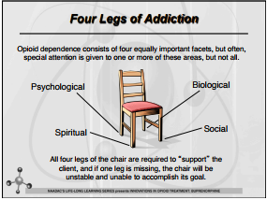

Slide 20
Ethics
Don’t get over an addiction by stop using
Accrues by creating a New Life were its easier not to use
If you don’t create a New Life, then all the factors that brought you to your D.O.C will catch up with you again
Addiction is a lie
It is very important not to lie to get someone into treatment
Justice – impartiality & equality
Autonomy – clients decide their own lives
Beneficence – help them, do good
Nonmaleficence– do no harm, Hippocratic oath
Fidelity – tell the truth

Slide 21
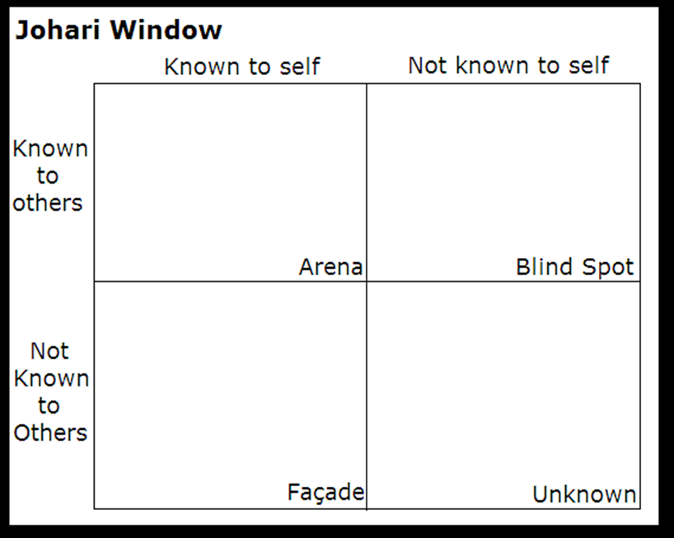
- Become addicted for various reasons
- Root cause

Slide 22
Rehab in Sin City
Statistically we see similar CD rates as others
Statistics on highest benzo/opioid use at Solutions
17 DUI’s, ½ Gallon alcohol per day, 100 Oxycodones, & Dozens of Benzos
Some of the most acutely addicted people in the world

Slide 23
What Works?
Abstinence
Harm Reduction
Moderation Management
Aversion Therapy

Slide 24
Abstinence
How long does drug addiction treatment usually last?
Individuals progress through drug addiction treatment at various rates, so there is no predetermined length of treatment. However, research has shown unequivocally that good outcomes are contingent on adequate treatment length. Generally, for residential or outpatient treatment, participation for less than 90 days is of limited effectiveness, and treatment lasting significantly longer is recommended for maintaining positive outcomes. For methadone maintenance, 12 months is considered the minimum, and some opioid-addicted individuals continue to benefit from methadone maintenance for many years.
Good outcomes are contingent on adequate treatment length.
Treatment dropout is one of the major problems encountered by treatment programs; therefore, motivational techniques that can keep patients engaged will also improve outcomes. By viewing addiction as a chronic disease and offering continuing care and monitoring, programs can succeed, but this will often require multiple episodes of treatment and readily readmitting patients that have relapsed.

Slide 25
Harm Reduction
a set of practical strategies and ideas aimed at reducing negative consequences associated with drug use. Harm Reduction is also a movement for social justice built on a belief in, and respect for, the rights of people who use drugs.

Slide 26
Moderation Method
Alcohol consumption is associated with a variety of short- and long-term health risks, including motor vehicle crashes, violence, sexual risk behaviors, high blood pressure, and various cancers (e.g., breast cancer).¹
The risk of these harms increases with the amount of alcohol you drink. For some conditions, like some cancers, the risk increases even at very low levels of alcohol consumption (less than1 drink).^{2,3}
To reduce the risk of alcohol-related harms, the 2015-2020 U.S. Dietary Guidelines for Americans recommends that if alcohol is consumed, it should be consumed in moderation—up to one drink per day for women and two drinks per day for men—and only by adults of legal drinking age. This is not intended as an average over several days, but rather the amount consumed on any single day.⁴ The Guidelines also do not recommend that individuals who do not drink alcohol start drinking for any reason.⁴
Two in three adult drinkers report drinking above moderate levels at least once a month.⁵

Slide 27
Aversion Therapy
Aversion therapy is a form of psychological treatment in which the patient is exposed to a stimulus while simultaneously being subjected to some form of discomfort. This conditioning is intended to cause the patient to associate the stimulus with unpleasant sensations with the intention of quelling the targeted (sometimes compulsive) behavior.

Slide 28
ABSTINENCE
  Easiest thing/Hardest thing
  Easiest thing VS. Hardest thing
  Change everything VS. No major changes
  You are powerless VS. Take control of your life
  2 Problems – More than I should, convinced to use again
  Spiritual and Altruistic plane
  1-3. Trust God
  4-11. Clean House
  12. Help Others

Slide 29
Family Disease
Family
3 Things can happen
    Family participates in treatment
    Family doesn’t & stays sick
      Addict extricates from system
    Addict relapses

Slide 30
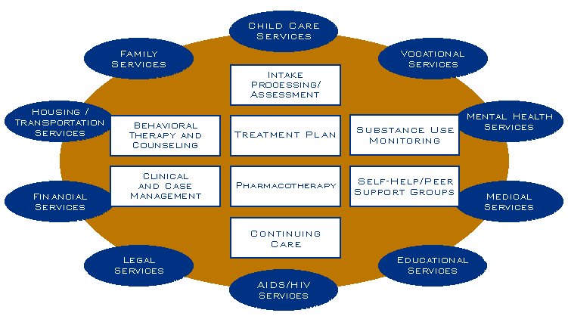
Components of Comprehensive Drug Abuse Treatment

Slide 31
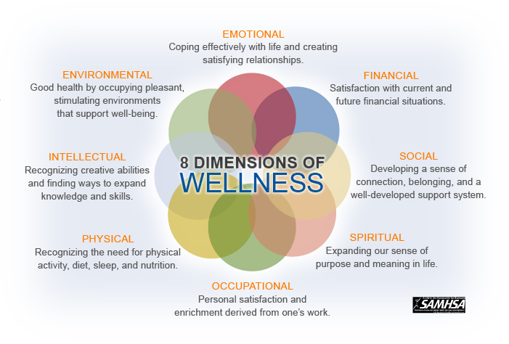

Slide 32

How long does drug addiction treatment usually last?
Individuals progress through drug addiction treatment at various rates, so there is no predetermined length of treatment. However, research has shown unequivocally that good outcomes are contingent on adequate treatment length. Generally, for residential or outpatient treatment, participation for less than 90 days is of limited effectiveness, and treatment lasting significantly longer is recommended for maintaining positive outcomes. For methadone maintenance, 12 months is considered the minimum, and some opioid-addicted individuals continue to benefit from methadone maintenance for many years.

Slide 33
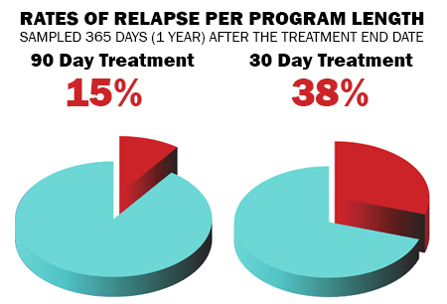
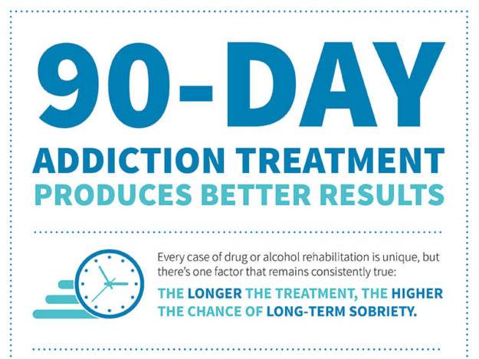
NIDA
90 DAY PROMISE
Research has shown that treatment must last, on average, at least 3 months to produce stable behavior change. While the exact length of time will vary by individual, programs lasting at least 90 days (and preferably longer) have been shown to be much more effective in reducing drug abuse and criminal activity, compared to those lasting less than 90 days.

Slide 34
I know I’m an Alcoholic because I misplace things, like a decade.

Slide 35
Once in a lifetime opportunity at Solutions…
You have the power in this process.

Slide 36
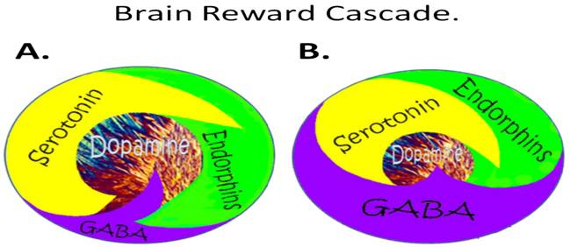
Reward Deficiency Syndrome
Schematic of the brain reward cascade: normal and abnormal representation.
A: The normal physiologic state of the neurotransmitter interaction at the mesolimbic region of the brain. Briefly, serotonin in the hypothalamus stimulates neuronal projections ...

Slide 37
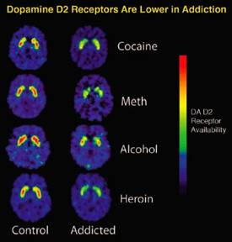
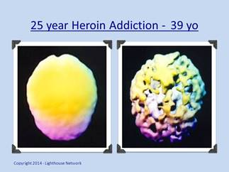
Brain Disease

Slide 38
Signs & Symptoms
Opiates:
  Dry mouth
  Constipation
  Sweating
  Feeling lightheaded
  Feeling euphoric and overly elated
  Constricted pupils
  Flushed face
  Lack of coordination
  Sleeping too much or sleeping too little
Amphetamines:
  Increased body temperature
  Euphoria
  Increased blood pressure
  Dry mouth
  Faster breathing
  Dilated pupils
  Increased energy and alertness
  Decreased fatigue
  Decreased appetite

Slide 39

Thank You!
Questions?

